Slide 1
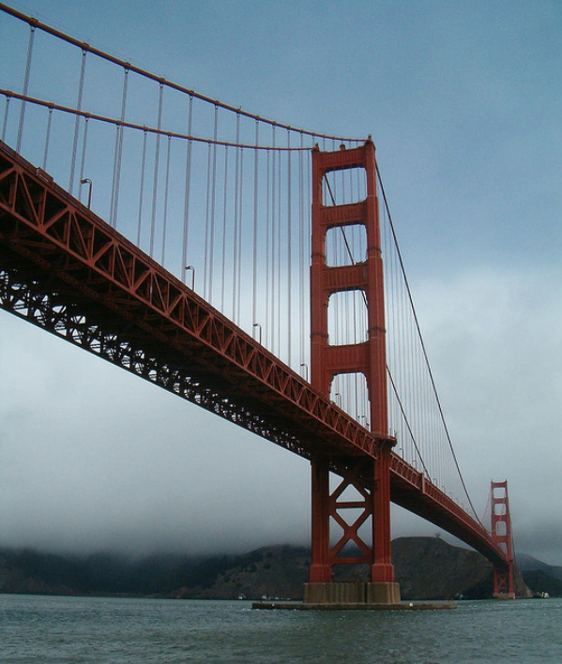
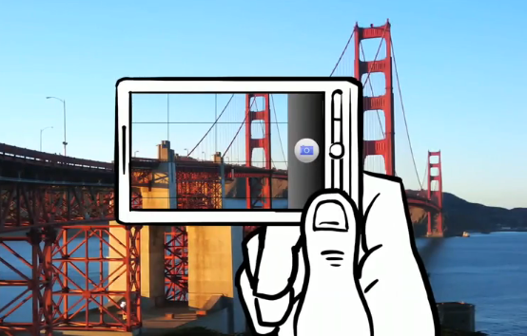
Feature descriptors and matching

Slide 2
Application Of Feature Detection And Matching
Automate object tracking
Point matching for computing disparity
Stereo calibration(Estimation of the fundamental matrix)
Motion-based segmentation
Recognition
3D object reconstruction
Robot navigation
Image retrieval and indexing

Slide 3
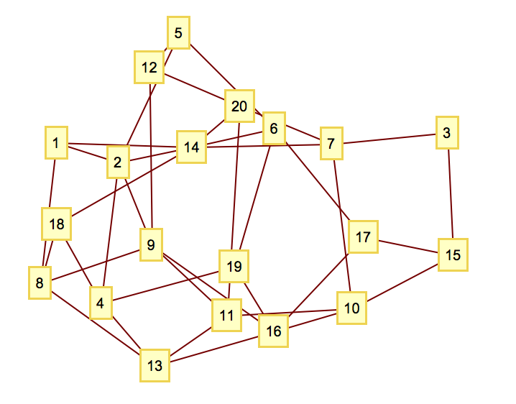
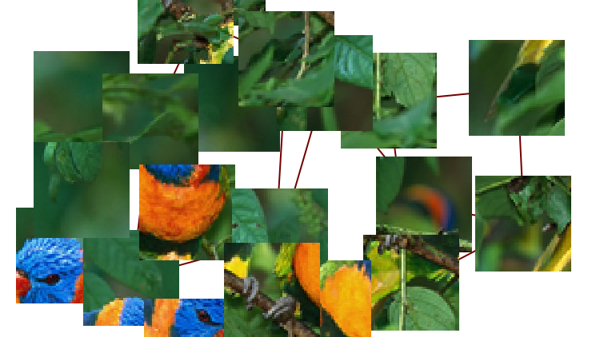
How did you solve the problem?

Slide 4
Feature
A feature is a piece of information which is relevant for solving the computational task related to a certain application.
may be specific structures in the image such as points, edges or objects
may also be the result of a general neighborhood operation or feature detection applied to the image

Slide 5
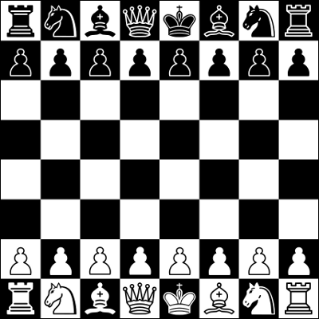





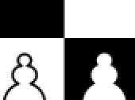

Good Feature of an Image
Flat Region
Edge
Corner
Feature

Slide 6
Good Feature of an Image
Flat Region
Edge
Corner
Feature

Slide 7
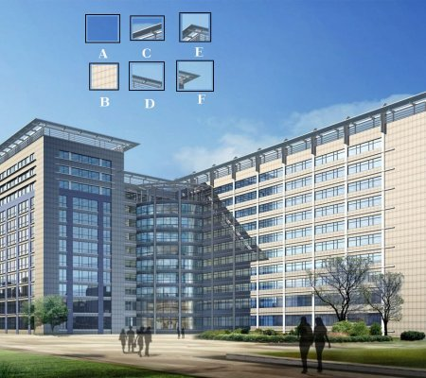

Slide 8
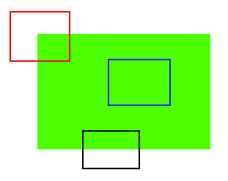

Slide 9


Feature descriptors
We know how to detect good points
Next question: How to match them?
Answer: Come up with a descriptor for each point, find similar descriptors between the two images
?

Slide 10
Feature descriptors
We know how to detect good points
Next question: How to match them?
Lots of possibilities
Simple option: match square windows around the point
State of the art approach: SIFT
David Lowe, UBC http://www.cs.ubc.ca/~lowe/keypoints/
?

Slide 11
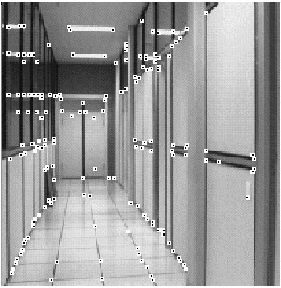
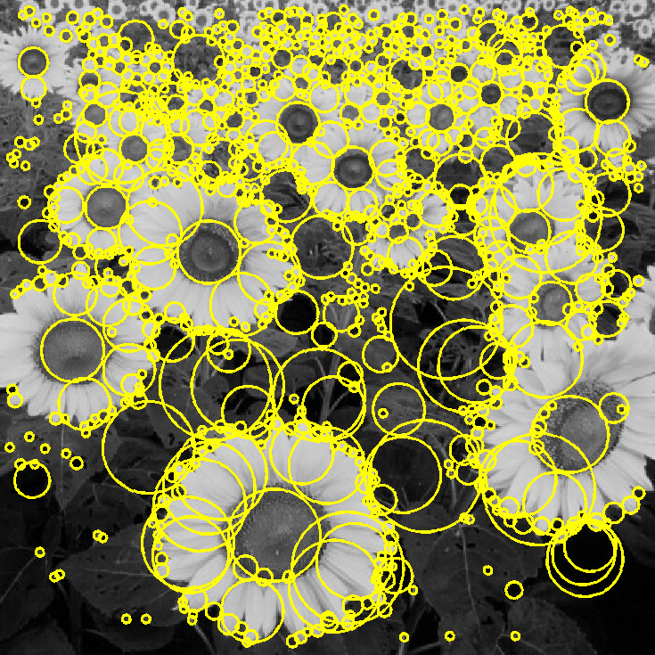
Feature extraction: Corners and blobs

Slide 12
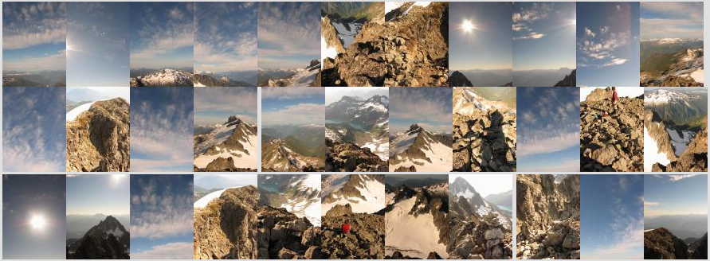
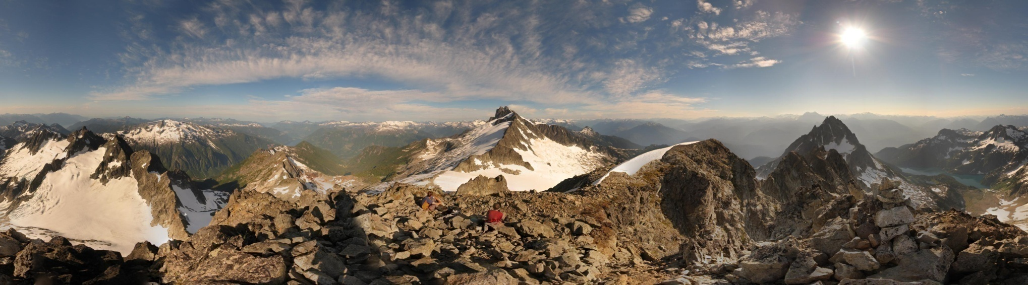
Motivation: Automatic panoramas
Credit: Matt Brown

Slide 13
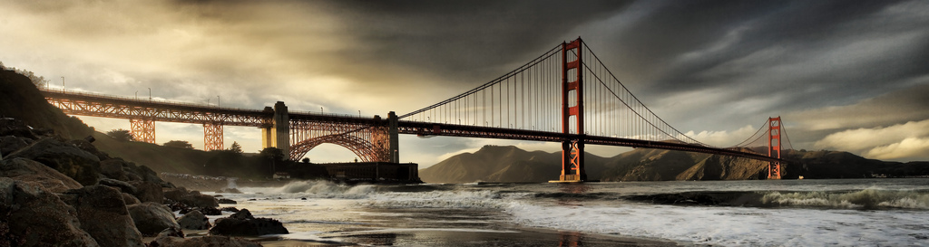
Motivation: Automatic panoramas
GigaPan
http://gigapan.com /
Also see Google Zoom Views:
https://www.google.com/culturalinstitute/beta/project/gigapixels

Slide 14


Why extract features?
Motivation: panorama stitching
We have two images – how do we combine them?

Slide 15
Why extract features?
Motivation: panorama stitching
We have two images – how do we combine them?
Step 1: extract features
Step 2: match features

Slide 16

Why extract features?
Motivation: panorama stitching
We have two images – how do we combine them?
Step 1: extract features
Step 2: match features
Step 3: align images

Slide 17
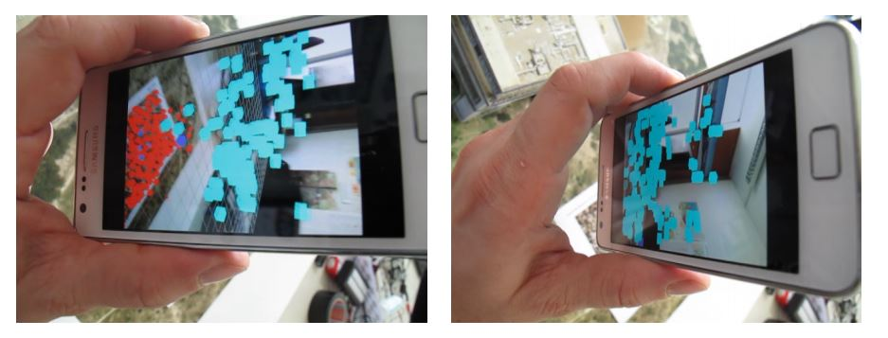
Application: Visual SLAM
(aka Simultaneous Localization and Mapping)

Slide 18
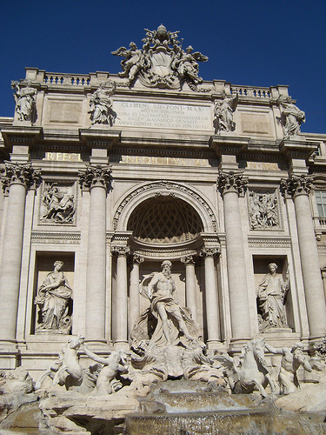
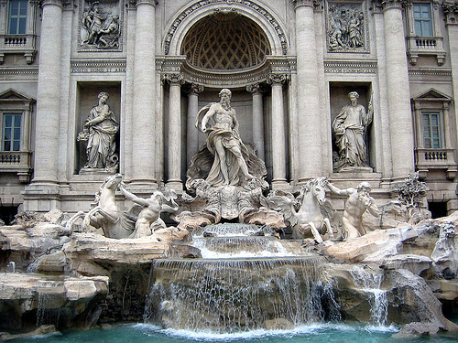
Image matching
by Diva Sian
by swashford
TexPoint fonts used in EMF.
Read the TexPoint manual before you delete this box.: AAAAAA

Slide 19
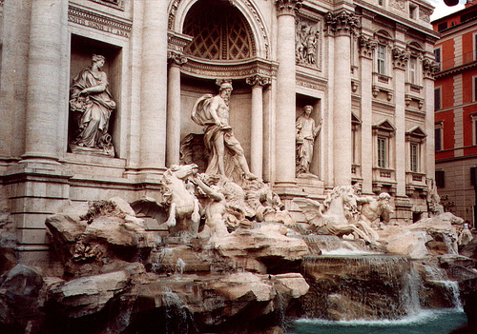
Harder case
by Diva Sian
by scgbt

Slide 20
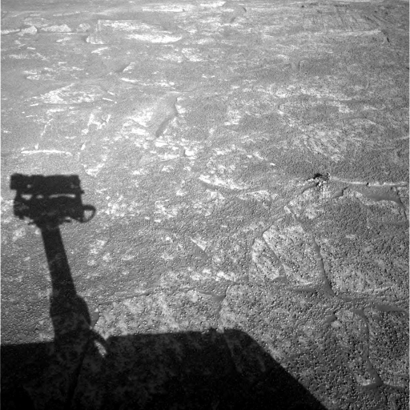
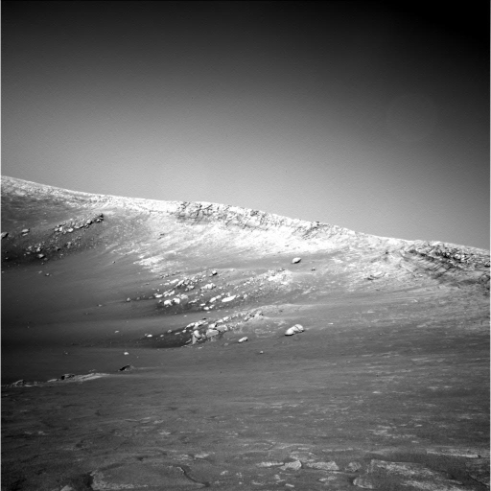
Harder still?

Slide 21
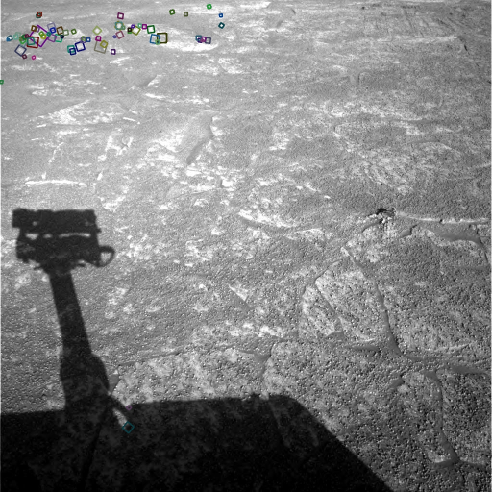
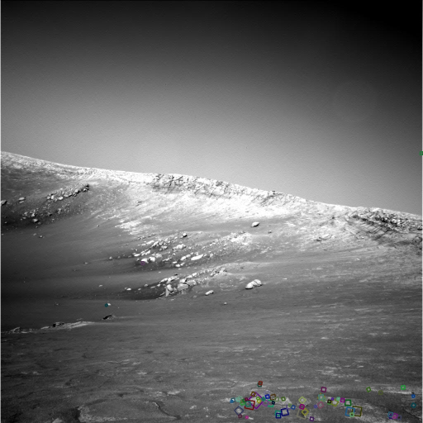
Answer below (look for tiny colored squares…)
NASA Mars Rover images
with SIFT feature matches

Slide 22
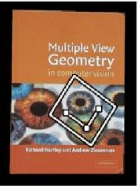

Feature Matching

Slide 23


Feature Matching

Slide 24
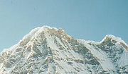
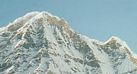
Local features: main components
Detection: Identify the interest points
Description: Extract vector feature descriptor surrounding each interest point.
Matching: Determine correspondence between descriptors in two views
Kristen Grauman

Slide 25
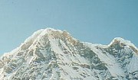
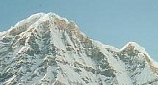
Common Requirements
Problem 1:
Detect the same point independently in both images
Problem 2:
For each point correctly recognize the corresponding one
?
We need a reliable and distinctive descriptor!
Lecture 6 -

Slide 26
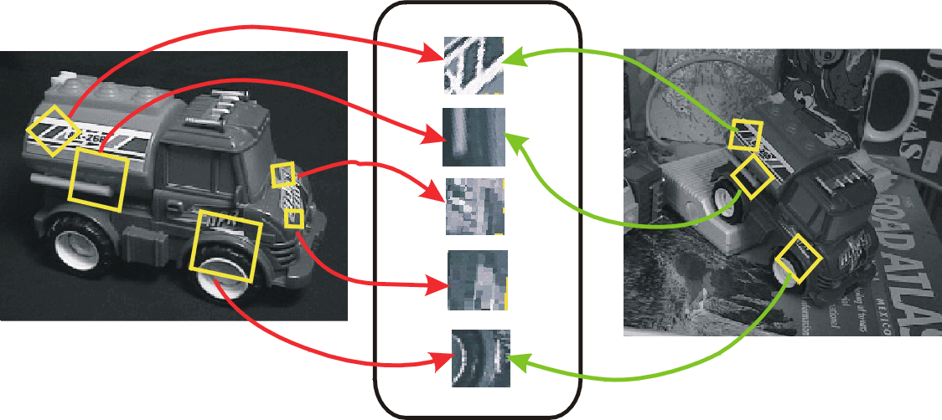
Invariant local features
Find features that are invariant to transformations
geometric invariance: translation, rotation, scale
photometric invariance: brightness, exposure, …
Feature Descriptors

Slide 27
Advantages of local features
Locality
features are local, so robust to occlusion and clutter
Quantity
hundreds or thousands in a single image
Distinctiveness:
can differentiate a large database of objects
Efficiency
real-time performance achievable

Slide 28
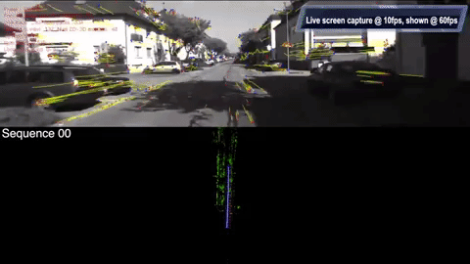
More motivation…
Feature points are used for:
Image alignment
(e.g., mosaics)
3D reconstruction
Motion tracking
(e.g. for AR)
Object recognition
Image retrieval
Robot navigation
… other

Slide 29
Invariance vs. discriminability
Invariance:
Descriptor shouldn’t change even if image is transformed
Discriminability:
Descriptor should be highly unique for each point

Slide 30
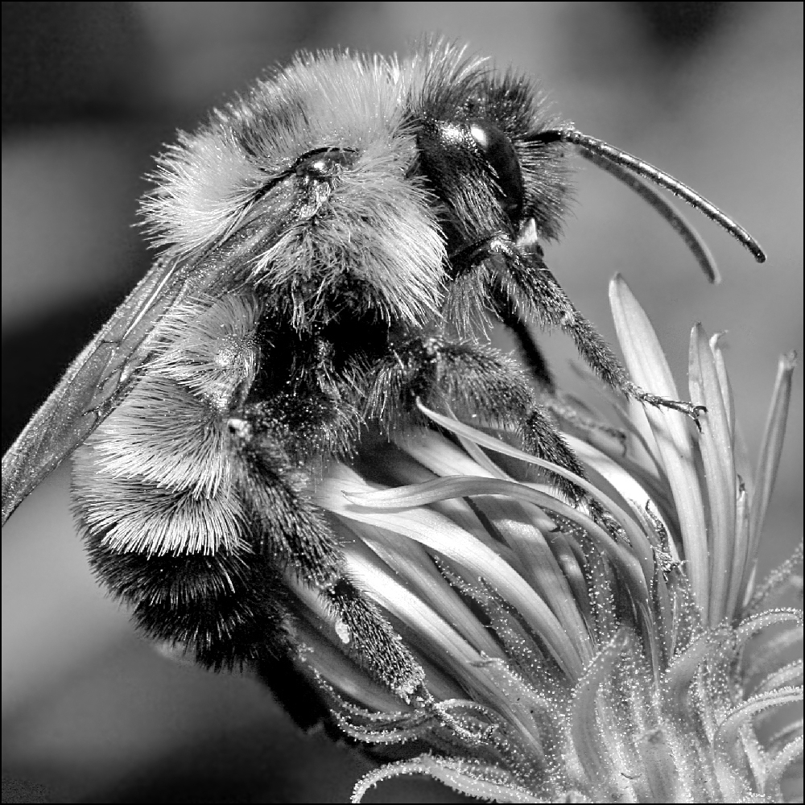
Image transformations revisited
Geometric
Rotation
Scale
Photometric
Intensity change

Slide 31
Approach
1. Feature detection: find it
2. Feature descriptor: represent it
3. Feature matching: match it
Feature tracking: track it, when motion

Slide 32
Local features: main components
Detection: Identify the interest points
Description: Extract vector feature descriptor surrounding each interest point.
Matching: Determine correspondence between descriptors in two views
Kristen Grauman

Slide 33
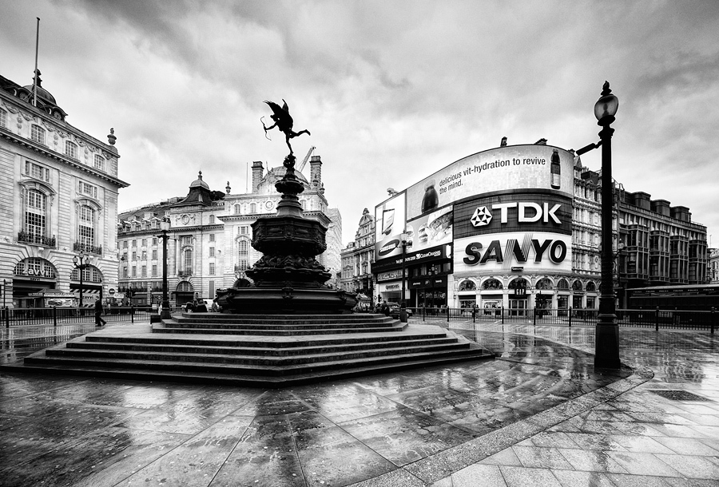
What makes a good feature?
Snoop demo

Slide 34
Want uniqueness
Look for image regions that are unusual
Lead to unambiguous matches in other images
How to define “unusual”?

Slide 35
Local measures of uniqueness
Suppose we only consider a small window of pixels
What defines whether a feature is a good or bad candidate?
Credit: S. Seitz, D. Frolova, D. Simakov
Notes:
High level idea is that corners are good. You want to find windows that contain strong gradients AND gradients oriented in more than one direction

Slide 36
Local measures of uniqueness
How does the window change when you shift it?
Shifting the window in any direction causes a big change
“flat” region: no change in all directions
“edge”:
no change along the edge direction
“corner”: significant change in all directions
Credit: S. Seitz, D. Frolova, D. Simakov

Slide 37
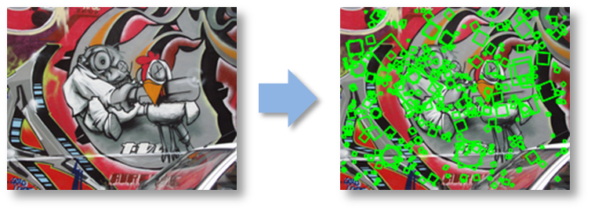
Harris corner detection

Slide 38
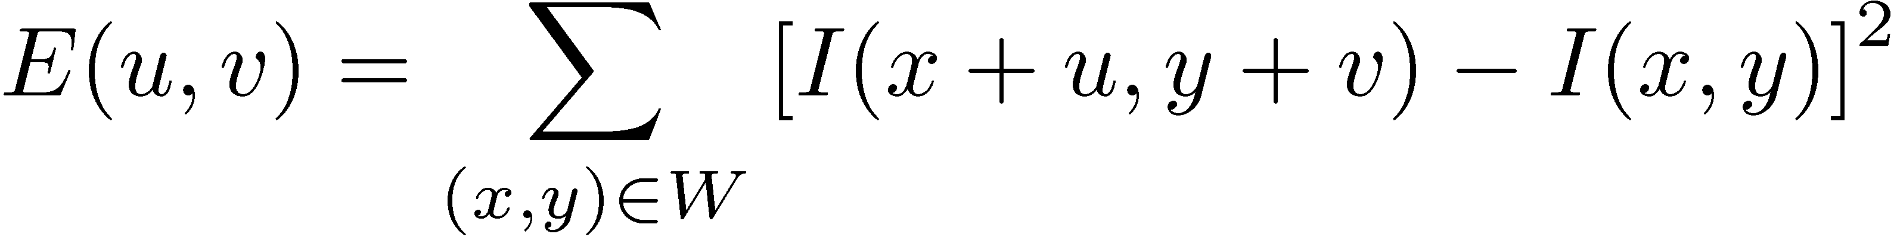
Harris corner detection: the math
Consider shifting the window W by (u,v)
how do the pixels in W change?
compare each pixel before and after by summing up the squared differences (SSD)
this defines an SSD “error” E(u,v):
We are happy if this error is high
Slow to compute exactly for each pixel and each offset (u,v)
_{(u,v)}
W

Slide 39
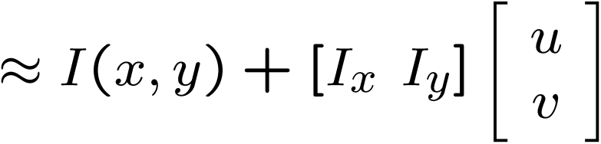
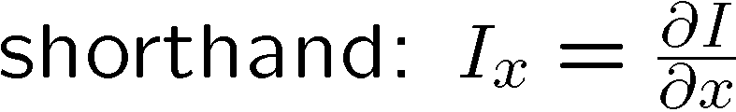
Small motion assumption
Taylor Series expansion of I:
If the motion (u,v) is small, then first order approximation is good
Plugging this into the formula on the previous slide…

Slide 40
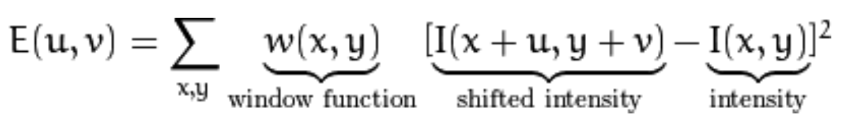
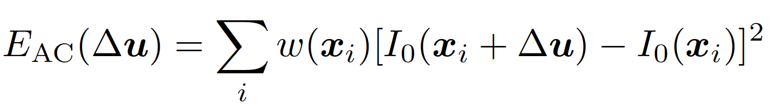
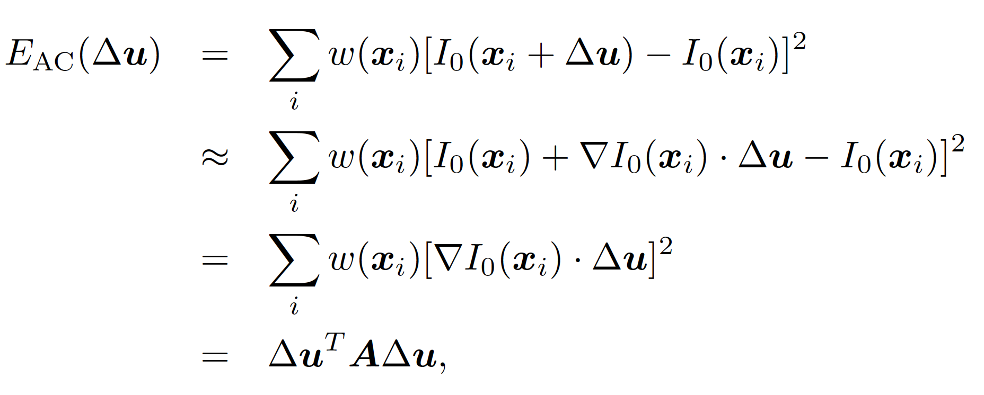
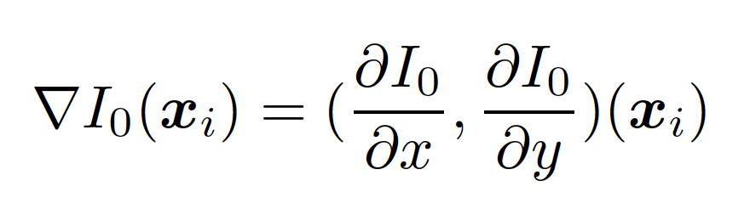
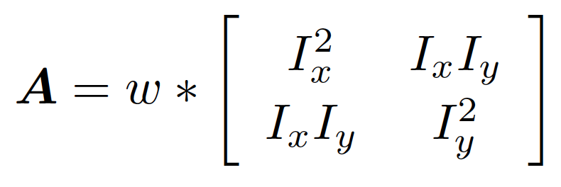
Minimization using Auto-Correction Matrix
Cite: Richard Szeliski

Slide 41
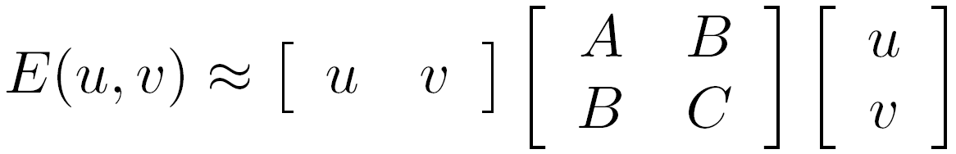

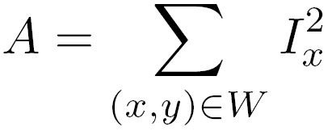
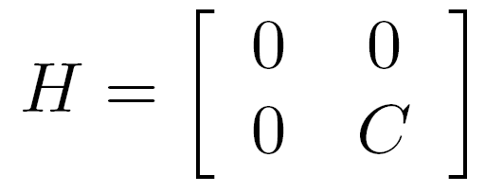
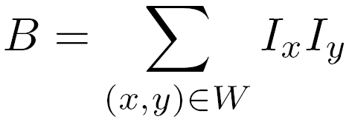
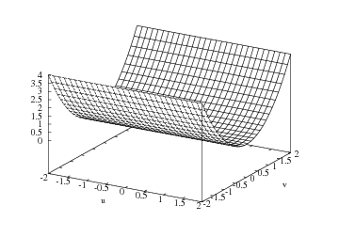
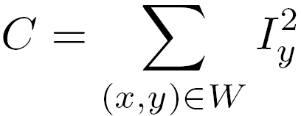
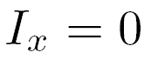
E(u,v)
Horizontal edge:
v
u

Slide 42
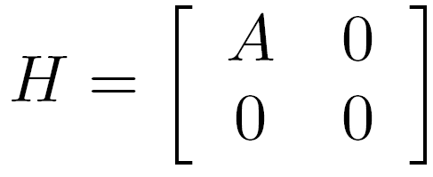
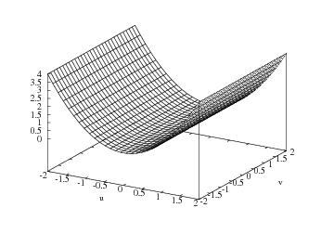
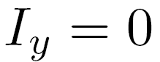
E(u,v)
Vertical edge:
v
u

Slide 43
Here, I_{x} and I_{y} are image derivatives in x and y directions respectively. (Can be easily found out using cv2.Sobel()).
Created an equation, which will determine if a window can contain a corner or not.
R = det(H) - k(trace(H))²
where
det(H) = λ1 λ2
trace(H) = λ1 + λ2
λ1 and λ2
are the eigen values of H

Slide 44
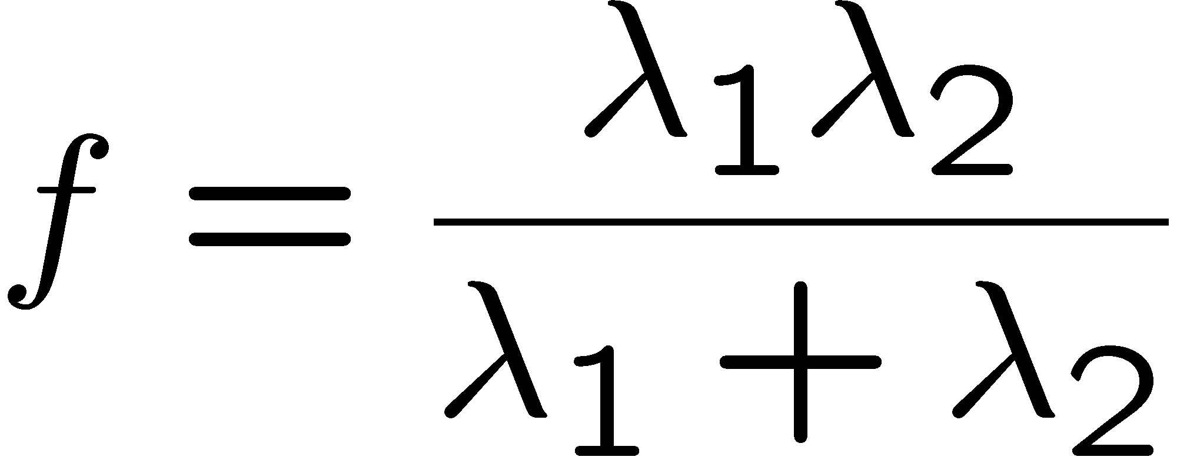

The Harris operator
The trace is the sum of the diagonals, i.e., trace(H) = h₁₁ + h₂₂
Called the “Harris Corner Detector” or “Harris Operator”
Lots of other detectors, this is one of the most popular

Slide 45
General case
We can visualize H as an ellipse with axis lengths determined by the eigenvalues of H and orientation determined by the eigenvectors of H
λ_{max}, λ_{min} : eigenvalues of H
Ellipse equation:
direction of the fastest change
direction of the slowest change
(λ_{max})^{-1/2}
(λ_{min})^{-1/2}

Slide 46
So the values of these eigen values decide whether a region is corner, edge or flat.
When |R| is small, which happens when λ1 and λ2 are small, the region is flat.
When R<0, which happens when λ1 >> λ2 or vice versa, the region is edge.
When R is large, which happens when λ1 and λ2 are large and λ1 ~ λ2, the region is a corner.

Slide 47
Interpreting the eigenvalues
Classification of image points using eigenvalues of H:
λ₂
“Edge” λ₂ >> λ₁
“Corner” λ₁ and λ₂ are large, λ₁ ~ λ₂; E increases in all directions
λ₁ and λ₂ are small; E is almost constant in all directions
“Flat” region
“Edge” λ₁ >> λ₂
λ₁

Slide 48
So the result of Harris Corner Detection is a grayscale image with these scores. Thresholding for a suitable give you the corners in the image

Slide 49
Take the grayscale of the original image
Apply a Gaussian filter to smooth out any noise
Apply Sobel operator to find the x and y gradient values for every pixel in the grayscale image
For each pixel p in the grayscale image, consider a 3×3 window around it and compute the corner strength function. Call this its Harris value.
Find all pixels that exceed a certain threshold and are the local maxima within a certain window (to prevent redundant dupes of features)

Slide 50

OpenCV Functions
cv2.cornerHarris(img, blockSize, ksize, k)
img - Input image, it should be grayscale and float32 type.
blockSize - It is the size of neighbourhood considered for corner detection
ksize - Aperture parameter of Sobel derivative used.
k - Harris detector free parameter in the equation.
cv2.cornerSubPix()
For sub-pixel accuracy

Slide 51
Harris Corner Detector in OpenCV
Code

Slide 52


Slide 53

Harris detector example

Slide 54

f value (red high, blue low)

Slide 55

Threshold (f > value)

Slide 56

Find local maxima of f

Slide 57

Harris features (in red)

Slide 58
Invariance
Suppose we are comparing two images I₁ and I₂
I₂ may be a transformed version of I₁
What kinds of transformations are we likely to encounter in practice?

Slide 59
Scale invariant detection
Suppose you’re looking for corners
Key idea: find scale that gives local maximum of f
in both position and scale
One definition of f: the Harris operator
Notes:
Show other scales and how the feature looks less corner like

Slide 60
Invariance
Suppose you rotate the image by some angle
Will you still pick up the same features?
What if you translate the image instead?
Change in brightness?
Scale?
Notes:
Yes (with some caveats—image resampling errors…)

Slide 61
Invariant descriptors
We looked at invariant / equivariant detectors
Most feature descriptors are also designed to be invariant to
Translation, 2D rotation, scale
They can usually also handle
Limited 3D rotations (SIFT works up to about 60 degrees)
Limited affine transforms (some are fully affine invariant)
Limited illumination/contrast changes

Slide 62
Invariance and equivariance
We want corner locations to be invariant to photometric transformations and equivariant to geometric transformations
Invariance: image is transformed and corner locations do not change
Equivariance: if we have two transformed versions of the same image, features should be detected in corresponding locations
(Sometimes “invariant” and “equivariant” are both referred to as “invariant”)
(Sometimes “equivariant” is called “covariant”)

Slide 63
Harris detector: Invariance properties -- Image rotation
Second moment ellipse rotates but its shape (i.e. eigenvalues) remains the same
Corner location is equivariant w.r.t. image rotation

Slide 64
Harris Detector: Invariance Properties
Scaling
Corner
All points will be classified as edges
Neither invariant nor equivariant to scaling

Slide 65
SIFT: Motivation
The Harris operator is not invariant to scale and correlation is not invariant to rotation^{1.}
For better image matching, Lowe’s goal was to develop an interest operator that is invariant to scale and rotation.
Also, Lowe aimed to create a descriptor that was robust to the variations corresponding to typical viewing conditions. The descriptor is the most-used part of SIFT.
¹But Schmid and Mohr developed a rotation invariant descriptor for it in 1997.

Slide 66
Idea of SIFT
Image content is transformed into local feature coordinates that are invariant to translation, rotation, scale, and other imaging parameters
SIFT Features

Slide 67
Claimed Advantages of SIFT
Locality: features are local, so robust to occlusion and clutter (no prior segmentation)
Distinctiveness: individual features can be matched to a large database of objects
Quantity: many features can be generated for even small objects
Efficiency: close to real-time performance
Extensibility: can easily be extended to wide range of differing feature types, with each adding robustness

Slide 68
Overall Procedure at a High Level
Scale-space extrema detection
Keypoint localization
Orientation assignment
Keypoint description
Search over multiple scales and image locations.
Fit a model to detrmine location and scale.
Select keypoints based on a measure of stability.
Compute best orientation(s) for each keypoint region.
Use local image gradients at selected scale and rotation
to describe each keypoint region.

Slide 69
Constructing the Scale Space
use the Gaussian Blurring technique to reduce the noise in an image.
Scale space is a collection of images having different scales, generated from a single image.
images of multiple scales (often represented by σ)
To create a new set of images of different scales, take the original image and reduce the scale by half.
For each new image, create blur versions

Slide 70



Example: Subsampling with Gaussian pre-filtering
G 1/8
G 1/4
Gaussian 1/2

Slide 71
Gaussian Pyramid At each level, image is smoothed and reduced in size.
And so on.
At 2nd level, each pixel is the result
of applying a Gaussian mask to
the first level and then subsampling
to reduce the size.
Apply Gaussian filter
Bottom level is the original image.

Slide 72



Note: The LoG and DoG operators are both rotation equivariant
covariant

Slide 73
Lowe’s Pyramid Scheme
Scale space is separated into octaves:
Octave 1 uses scale σ
Octave 2 uses scale 2σ
etc.
In each octave, the initial image is repeatedly convolved
with Gaussians to produce a set of scale space images.
Adjacent Gaussians are subtracted to produce the DOG
After each octave, the Gaussian image is down-sampled
by a factor of 2 to produce an image ¼ the size to start
the next level.

Slide 74
How many times do need to scale the image and how many subsequent blur images need to be created for each scaled image?
The ideal number of octaves should be four, and for each octave, the number of blur images should be five.

Slide 75
Difference of Gaussian
Difference of Gaussian is a feature enhancement algorithm that involves the subtraction of one blurred version of an original image from another, less blurred version of the original.
DoG creates another set of images, for each octave, by subtracting every image from the previous image in the same scale.

Slide 76

Difference of Gaussian

Slide 77

Lowe’s Pyramid Scheme
s+2 filters
σ_{s+1}=2^{(s+1)/s}σ₀
.
.
σ_{i}=2^{i/s}σ₀
.
.
σ₂=2^{2/s}σ₀
σ₁=2^{1/s}σ₀
σ₀
s+3
images
including
original
s+2
differ-
ence
images
The parameter s determines the number of images per octave.

Slide 78

Key point localization
s+2 difference images.
top and bottom ignored.
s planes searched.
Detect maxima and minima of difference-of-Gaussian in scale space
Each point is compared to its 8 neighbors in the current image and 9 neighbors each in the scales above and below
For each max or min found,
output is the location and
the scale.

Slide 79
Keypoint Localization
Find the local maxima and minima
To locate the local maxima and minima, we go through every pixel in the image and compare it with its neighboring pixels.
For example, we have three images from the first octave. The pixel marked x is compared with the neighboring pixels (in green) and is selected as a keypoint if it is the highest or lowest among the neighbors:
Remove low contrast keypoints (keypoint selection)

Slide 80
Keypoint Selection
eliminate the keypoints that have low contrast, or lie very close to the edge.
To deal with the low contrast keypoints, a second-order Taylor expansion is computed for each keypoint. If the resulting value is less than 0.03 (in magnitude), we reject the keypoint
to identify the poorly located keypoints. These are the keypoints that are close to the edge and have a high edge response but may not be robust to a small amount of noise. A second-order Hessian matrix is used to identify such keypoints.

Slide 81




Eliminating the Edge Response
Reject flats:
< 0.03
Reject edges:
r < 10
What does this look like?
Let α be the eigenvalue with
larger magnitude and β the smaller.
Let r = α/β.
So α = rβ
(r+1)²/r is at a
min when the
2 eigenvalues
are equal.

Slide 82
Orientation Assignment
For a set of stable keypoints for the images. assign an orientation to each of these keypoints so that they are invariant to rotation.
Calculate the magnitude and orientation
Create a histogram for magnitude and orientation

Slide 83

Calculate Magnitude and Orientation
Consider the sample image shown above:
Let’s say we want to find the magnitude and orientation for the pixel value in red. For this, we will calculate the gradients in x and y directions by taking the difference between 55 & 46 and 56 & 42. This comes out to be Gx = 9 and Gy = 14 respectively.

Slide 84
Once we have the gradients, we can find the magnitude and orientation using the following formulas:
Magnitude = √[(Gx)²+(Gy)²] = 16.64
Φ = atan(Gy / Gx) = atan(1.55) = 57.17
The magnitude represents the intensity of the pixel and the orientation gives the direction for the same.

Slide 85
Creating a Histogram for Magnitude and Orientation
On the x-axis, we will have bins for angle values, like 0-9, 10 – 19, 20-29, up to 360. Since our angle value is 57, it will fall in the 6th bin. The 6th bin value will be in proportion to the magnitude of the pixel, i.e. 16.64. We will do this for all the pixels around the keypoint.

Slide 86


Slide 87
This histogram would peak at some point. The bin at which we see the peak will be the orientation for the keypoint. Additionally, if there is another significant peak (seen between 80 – 100%), then another keypoint is generated with the magnitude and scale the same as the keypoint used to generate the histogram. And the angle or orientation will be equal to the new bin that has the peak.

Slide 88

3. Orientation assignment
Create histogram of local gradient directions at selected scale
Assign canonical orientation at peak of smoothed histogram
Each key specifies stable 2D coordinates (x, y, scale,orientation)
If 2 major orientations, use both.

Slide 89
4. Keypoint Descriptors
At this point, each keypoint has
location
scale
orientation
Next is to compute a descriptor for the local image region about each keypoint that is
highly distinctive
invariant as possible to variations such as changes in viewpoint and illumination
use the neighboring pixels, their orientations, and magnitude, to generate a unique fingerprint for this keypoint called a ‘descriptor’.

Slide 90

Scale Invariant Feature Transform
Basic idea:
Take 16x16 square window around detected feature
Compute edge orientation (angle of the gradient - 90°) for each pixel
Throw out weak edges (threshold gradient magnitude)
Create histogram of surviving edge orientations
0
2π
angle histogram
Adapted from slide by David Lowe

Slide 91
SIFT descriptor
Full version
Divide the 16x16 window into a 4x4 grid of cells (2x2 case shown below)
Compute an orientation histogram for each cell
16 cells * 8 orientations = 128 dimensional descriptor
Adapted from slide by David Lowe

Slide 92


Properties of SIFT
Extraordinarily robust matching technique
Can handle changes in viewpoint
Up to about 60 degree out of plane rotation
Can handle significant changes in illumination
Sometimes even day vs. night (below)
Fast and efficient—can run in real time
Lots of code available
http://people.csail.mit.edu/albert/ladypack/wiki/index.php/Known_implementations_of_SIFT

Slide 93


SIFT Example
sift
868 SIFT features

Slide 94

Other descriptors
HOG: Histogram of Gradients (HOG)
Dalal/Triggs
Sliding window, pedestrian detection
FREAK: Fast Retina Keypoint
Perceptually motivated
Used in Visual SLAM
LIFT: Learned Invariant Feature Transform
Learned via deep learning
https://arxiv.org/abs/1603.09114
Notes:
http://infoscience.epfl.ch/record/175537/files/2069.pdf
FREAK: Fast Retina Keypoint
The Binary Robust Independent Ele- mentary Feature (BRIEF) [5], the Oriented Fast and Ro- tated BRIEF (ORB)[26], and the Binary Robust Invariant Scalable Keypoints[16] (BRISK) are good examples.

Slide 95
Code

Slide 96


Slide 97
ORB (Oriented FAST and Rotated BRIEF)
An efficient alternative to SIFT or SURF in 2011.
ORB is basically a fusion of FAST keypoint detector and BRIEF descriptor with many modifications to enhance the performance

Slide 98

Which features match?

Slide 99
Feature matching
Given a feature in I₁, how to find the best match in I₂?
Define distance function that compares two descriptors
Test all the features in I₂, find the one with min distance

Slide 100

Feature distance
How to define the difference between two features f₁, f₂?
Simple approach: L₂ distance, ||f₁ - f₂ ||
can give small distances for ambiguous (incorrect) matches
f₁
f₂
I₁
I₂

Slide 101
Feature distance
How to define the difference between two features f₁, f₂?
Better approach: ratio distance = ||f₁ - f₂ || / || f₁ - f₂’ ||
f₂ is best SSD match to f₁ in I₂
f₂’ is 2nd best SSD match to f₁ in I₂
gives large values for ambiguous matches
f₁
f₂'
f₂
I₁
I₂

Slide 102
Feature distance
Does the SSD vs “ratio distance” change the best match to a given feature in image 1?

Slide 103
Feature Matching
Brute-Force matcher it takes the descriptor of one feature in first set and is matched with all other features in second set using some distance calculation. And the closest one is returned.
For BF matcher,
first create the BFMatcher object using cv2.BFMatcher().
It takes two optional params. First one is normType. It specifies the distance measurement to be used.
By default, it is cv2.NORM_L2. It is good for SIFT, SURF etc (cv2.NORM_L1 is also there).
For binary string based descriptors like ORB, BRIEF, BRISK etc, cv2.NORM_HAMMING should be used, which used Hamming distance as measurement.

Slide 104
Feature Matching
Second param is boolean variable, crossCheck which is false by default.
If it is true, Matcher returns only those matches with value (i,j) such that i-th descriptor in set A has j-th descriptor in set B as the best match and vice-versa.
That is, the two features in both sets should match each other. It provides consistent result.

Slide 105
Feature Matching
Once it is created, two important methods are BFMatcher.match() and BFMatcher.knnMatch().
First one returns the best match.
Second method returns k best matches where k is specified by the user.
It may be useful when we need to do additional work on that.

Slide 106
Feature Matching
cv2.drawMatches() helps to draw the matches.
It stacks two images horizontally and draw lines from first image to second image showing best matches.
There is also cv2.drawMatchesKnn which draws all the k best matches.
If k=2, it will draw two match-lines for each keypoint. So need to pass a mask if need to selectively draw it.

Slide 107
enum | cv::DrawMatchesFlags { cv::DrawMatchesFlags::DEFAULT = 0, cv::DrawMatchesFlags::DRAW_OVER_OUTIMG = 1, cv::DrawMatchesFlags::NOT_DRAW_SINGLE_POINTS = 2, cv::DrawMatchesFlags::DRAW_RICH_KEYPOINTS = 4 }

Slide 108
Code

Slide 109


Slide 110



Feature matching example
58 matches (thresholded by ratio score)

Slide 111


Feature matching example
We’ll deal with outliers later
51 matches (thresholded by ratio score)

Slide 112
Evaluating the results
How can we measure the performance of a feature matcher?
50
75
200
feature distance

Slide 113
True/false positives
How can we measure the performance of a feature matcher?
The distance threshold affects performance
True positives = # of detected matches that are correct
Suppose we want to maximize these—how to choose threshold?
False positives = # of detected matches that are incorrect
Suppose we want to minimize these—how to choose threshold?
50
true match
75
200
false match
feature distance

Slide 114
Evaluating the results
How can we measure the performance of a feature matcher?
1
0.7
# true positives
# matching features (positives)
true positive rate
recall
0
1
false positive rate
0.1
# false positives
# unmatched features (negatives)
1 - specificity

Slide 115
Evaluating the results
How can we measure the performance of a feature matcher?
ROC curve (“Receiver Operator Characteristic”)
1
0.7
Single number: Area Under the Curve (AUC)
E.g. AUC = 0.87
1 is the best
# true positives
# matching features (positives)
true positive rate
recall
0
1
false positive rate
0.1
# false positives
# unmatched features (negatives)
1 - specificity

Slide 116
Template Matching
Template Matching is a method for searching and finding the location of a template image in a larger image.
OpenCV comes with a function cv2.matchTemplate() for this purpose.
It simply slides the template image over the input image (as in 2D convolution) and compares the template and patch of input image under the template image.
It returns a grayscale image, where each pixel denotes how much does the neighbourhood of that pixel match with template.

Slide 117
Template Matching
If input image is of size (WxH) and template image is of size (wxh),
output image will have a size of (W-w+1, H-h+1).
Once you got the result, you can use cv2.minMaxLoc() function to find where is the maximum/minimum value.
Take it as the top-left corner of rectangle and take (w,h) as width and height of the rectangle. That rectangle is your region of template.

Slide 118


Slide 119
Code

Slide 120

More on feature detection/description
http://www.robots.ox.ac.uk/~vgg/research/affine/
http://www.cs.ubc.ca/~lowe/keypoints/
http://www.vision.ee.ethz.ch/~surf/

Slide 121
Lots of applications
Features are used for:
Image alignment (e.g., mosaics)
3D reconstruction
Motion tracking
Object recognition
Indexing and database retrieval
Robot navigation
… other

Slide 122


Object recognition (David Lowe)

Slide 123


3D Reconstruction
Internet Photos (“Colosseum”)
Reconstructed 3D cameras and points

Slide 124

Sony Aibo
SIFT usage:
Recognize
charging
station
Communicate
with visual
cards
Teach object
recognition

Slide 125

Augmented Reality

Slide 126

Project 2: Feature detection and matching
http://www.cs.cornell.edu/courses/cs6670/2009fa/projects/p1/project1.html
Demo

Slide 127
Questions?

